Slide 1
Unit 5 – Cloud Security

Slide 2
Introduction
The set of control-based technologies and policies designed to adhere to regulatory compliance rules and protect information, data applications and infrastructure associated with cloud computing use
Cloud computing security processes should address the security controls the cloud provider will incorporate to maintain the customer's data security, privacy and compliance with necessary regulations

Slide 3
Challenges
Can you trust your data to your service provider?
With the cloud model, you lose control over physical security. In a public cloud, you are sharing computing resources with other companies
Exposing your data in an environment shared with other companies could give the government “reasonable cause” to seize your assets because another company has violated the law. Simply because you share the environment in the cloud, may put your data at risk of seizure

Slide 4
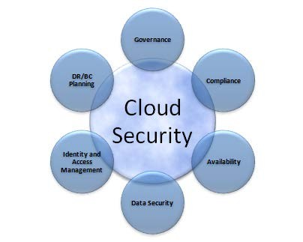
Challenges - Simply
Data Breaches
Misconfiguration
Unauthorized access
Data Loss
Compliance
General Data Protection Regulation (GDPR) and the Sarbanes-Oxley Act (SOX)

Slide 5
Data Control Security
When the cloud provider goes down
This scenario has a number of variants: bankruptcy, deciding to take the business
In another direction, or a widespread and extended outage. Whatever is going on,
you risk losing access to your production systems due to the actions of another company
You also risk that the organization controlling your data might not protect
It in accordance with the service levels to which they may have been previously committed.

Slide 6
Data Control Security (contd…)
When a subpoena compels your cloud provider to turn over your data
If the subpoena is directed at you, obviously you have to turn over the data to the courts, regardless of what precautions you take, but these legal requirements apply whether your data is in the cloud or on your own internal IT infrastructure. What we’re dealing with here is a subpoena aimed at your cloud provider that results from court action that has nothing to do with you.
To get at the data, the court will have to come to you and subpoena you. As a result, you will end up with the same level of control you have in your private data center.

Slide 7
Data Control Security (contd…)
When your cloud provider fails to adequately protect their network
When you select a cloud provider, you absolutely must understand how they treat physical, network, and host security. Though it may sound counter intuitive, the most secure cloud provider is one in which you never know where the physical server behind your virtual instance is running. Chances are that if you cannot figure it out, a determined hacker who is specifically targeting your organization is going to have a much harder time breaching the physical environment in which your data is hosted.
Nothing guarantees that your cloud provider will, in fact, live up to the standards and processes they profess to support.

Slide 8
SaaS Security Issues
The technology analyst and consulting firm Gartner lists seven security issues which one should discuss with a cloud-computing vendor:
Privileged User Access
Regulatory Issues
Data Location
Data Segregation
Recovery
Investigative Support
Long-term Viability

Slide 9
Security Monitoring
Supervises virtual and physical servers to continuously assess and measure data, application, or infrastructure behaviors for potential security threats
Assures that the cloud infrastructure and platform function optimally while minimizing the risk of costly data breaches.

Slide 10
Capabilities of Security Monitoring Software
Scalability
Tools must be able to monitor large volumes of data across many distributed locations
Visibility
The more visibility into application, user, and file behavior that a cloud monitoring solution provides, the better it can identify potential attacks or compromises
Timeliness
The best cloud security monitoring solutions will provide constant monitoring, ensuring that new or modified files are scanned in real time

Slide 11
contd …
Integration
Monitoring tools must integrate with a wide range of cloud storage providers to ensure full monitoring of an organization’s cloud usage
Auditing and Reporting
Cloud monitoring software should provide auditing and reporting capabilities to manage compliance requirements for cloud security

Slide 12
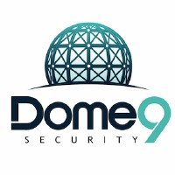
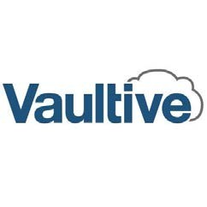
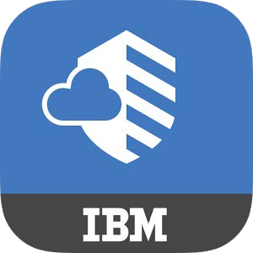
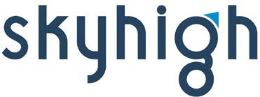
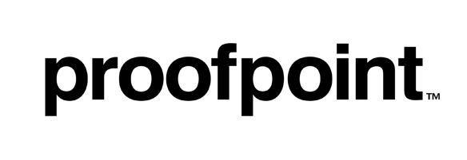
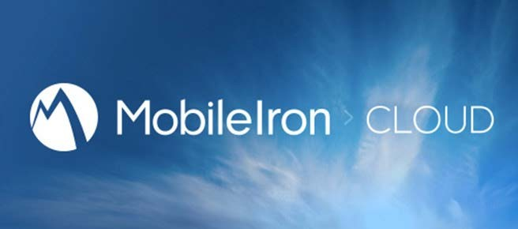
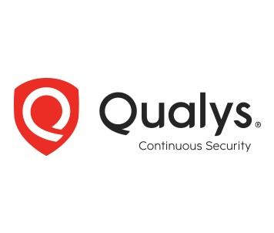
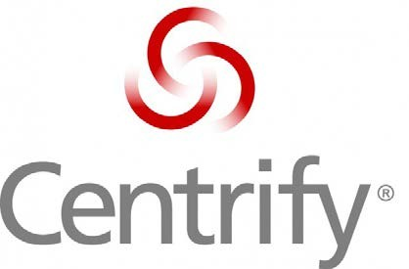
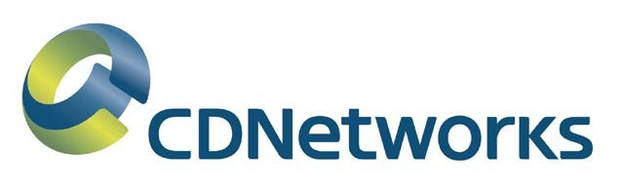
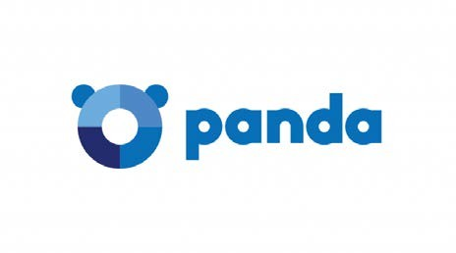
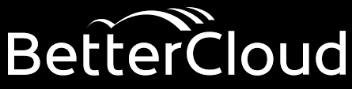
Some Cloud Security Tools
15

Slide 13
Incident Response
The process by which an organization handles a data breach or cyberattack, including the way the organization attempts to manage the consequences of the attack or breach (the “incident”)
Ultimately, the goal is to effectively manage the incident so that the damage is limited and both recovery time and costs, as well as collateral damage such as brand reputation, are kept at a minimum

Slide 14
Steps for Incident Response
Preparation
Identification
Containment
Eradication
Recovery
Lesson Learned

Slide 15
Security Architecture Design
A security architecture framework should be established with consideration of processes (enterprise authentication and authorization, access control, confidentiality, integrity, nonrepudiation, security management, etc.), operational procedures, technology specifications, people and organizational management, and security program compliance and reporting.
Technology and design methods should be included, as well as the security processes necessary to provide the following services across all technology layers:
Authentication
Authorization
Availability
Confidentiality
Integrity
Accountability
Privacy

Slide 16
Vulnerability Assessment
Vulnerability assessment classifies network assets to more efficiently prioritize vulnerability-mitigation programs, such as patching and system upgrading.
It measures the effectiveness of risk mitigation by setting goals of reduced vulnerability exposure and faster mitigation.
Vulnerability management should be integrated with discovery, patch management, and upgrade management processes to close vulnerabilities before they can be exploited.

Slide 17
Vulnerability Assessment
Vulnerability assessment is not penetration testing i.e. it does not simulate the external or internal cyber attacks that aims to breach the information security of the organization
A vulnerability assessment attempts to
identify the exposed vulnerabilities of a specific host,
or possibly an entire network

Slide 18
Data Privacy and Security
What is Data Privacy?
To preserve and protect any personal information, collected by any organization, from being accessed by a third party.
Determine what data within a system can be shared with others and which should be restricted.
What is Data Security?
Data Security refers to protecting data from unauthorized access and data corruption throughout its lifecycle.
Data security refers to data encryption, tokenization and key management practices that protect data across all applications and platforms.

Slide 19
Virtual Machine Security
Virtual machine (VM) security is a critical concern for organizations that use cloud computing
VMs are essentially software-based emulations of physical computers, and they can be used to run a variety of applications and services
Security threats:
VM escape: This is a type of attack that allows an attacker to gain control of a VM, even if they do not have direct access to the underlying physical host.
Cross-VM attacks: This is a type of attack that allows an attacker to attack one VM from another VM that is running on the same physical host.
Data breaches: VMs can be used to store sensitive data, such as customerPII or financial information. If a VM is compromised, this data could be exposed to unauthorized individuals.

Slide 20
VM Security Protection
Use a reputable cloud provider
Enable security features
Keep your software up to date
Use strong passwords and multi-factor authentication
Monitor your VMs for suspicious activity

Slide 21
Legal Issues and Aspects
Legal Issues
Liability
Data privacy
Compliance
Security
Aspects
Data encryption
Access control
Auditing
Incident Response

Slide 22
Multi Tenancy Issues
Multi-tenancy is a cloud computing model in which multiple tenants share the same physical infrastructure
This can save businesses money, but it also introduces security risks
Multi-tenancy Security Issues:
Data Isolation
Privilege Escalation
Shared Resources
Data Breaches

